Slide 1
Code Sample and Github Link
Techselector

Slide 2
GitHub Link
Here is the github link of the project
https://github.com/ajaygpt303/Tech-selector

Slide 3
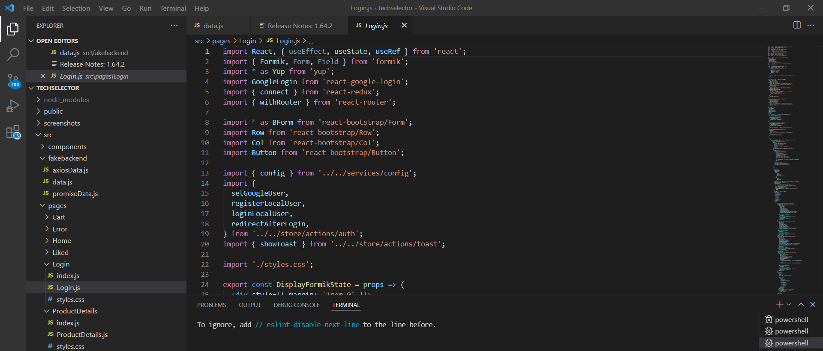
Github code screenshot and code samples

Slide 4
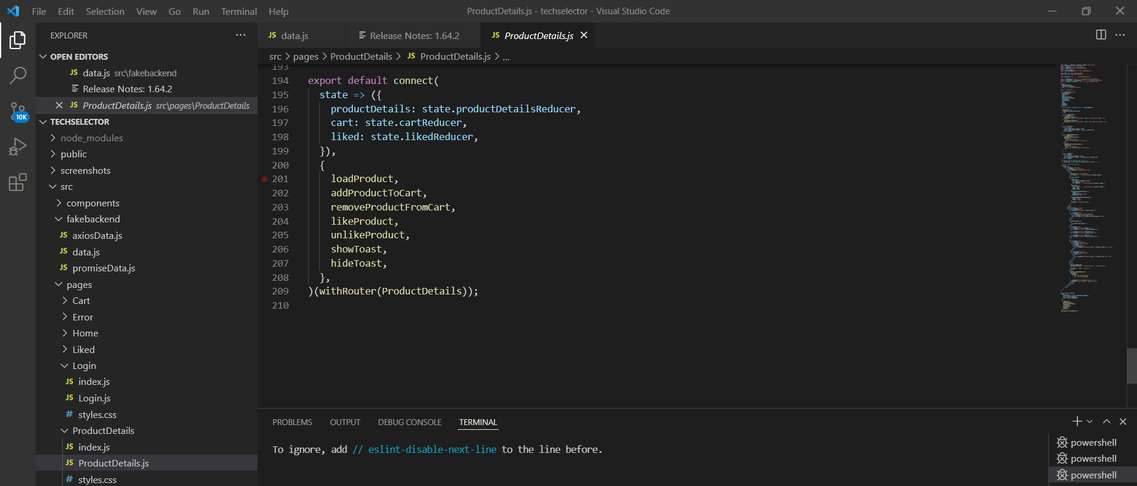

Slide 5
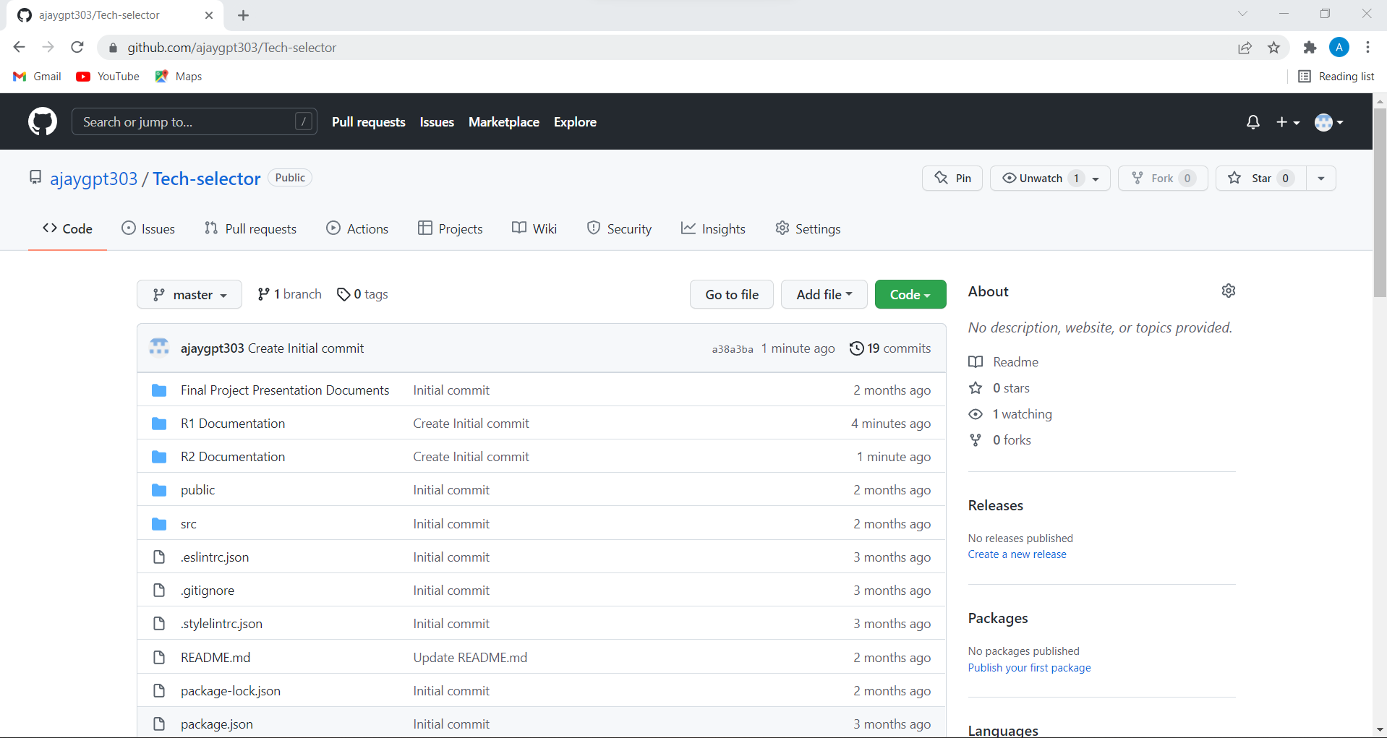

Slide 6
